Slide 1

PROJECT TITLE::SMART SORTING: Transfer Learning For Identifying Rotten Fruits and Vegetables
Welcome to our presentation on SMART SORTING. We aim to revolutionize fruit and vegetable sorting. Our team is dedicated to innovative solutions.

Slide 2

Project Phase 1
Team Leader: B.Rajyalakshmi
Team Members:
G.Lavnya
J.Neelima
P.Jasmine
T.Sreelekha
Notes:
upload image

Slide 3


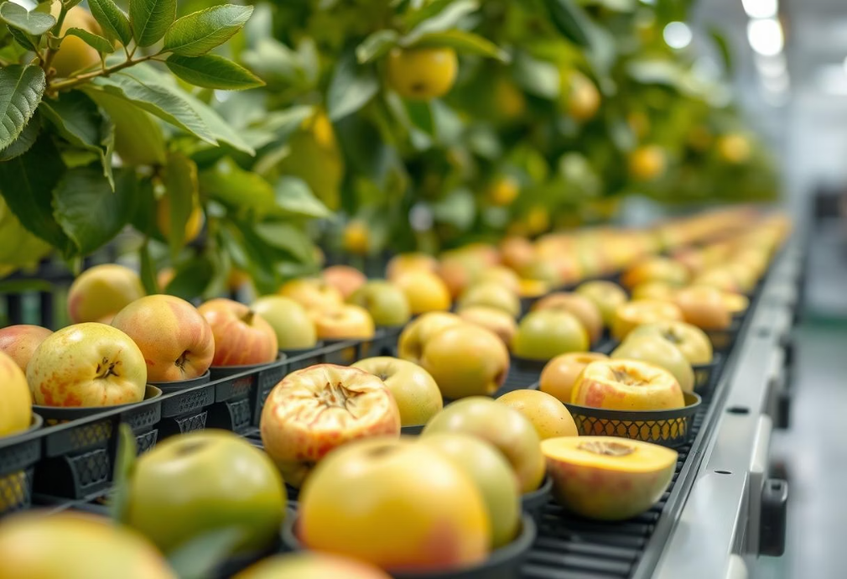

Phase 2: Requirement Analysis
Technical Requirements
Functional Requirements
The system must identify decay accurately. It needs real-time processing. User-friendly reporting is also required.
High-resolution image capture is crucial. We need robust data storage solutions. Edge computing capabilities are essential.
Constraints & Challenges
Variability in produce appearance is a challenge. Lighting conditions can vary. System integration must be seamless.

Slide 4



Phase 3: Project Design
System Architecture Diagram
Our architecture uses a cloud-based deep learning model. Data flows from local devices. It ensures scalable and efficient processing.
User Flow
UI/UX Considerations
Users upload images easily. The system processes them swiftly. Results are displayed clearly.
We prioritize intuitive interfaces. Visual feedback is immediate. The design is clean and accessible.

Slide 5


Phase 4: Project Planning (Agile Methodologies)
1
Sprint Planning
We define clear, achievable goals. Tasks are prioritized collaboratively. Daily stand-ups maintain focus.
2
Task Allocation
Responsibilities are assigned based on expertise. Team members cross-train for flexibility. We foster shared ownership.
3
Timelines & Milestones
We set realistic deadlines. Key milestones guide our progress. Regular reviews ensure we stay on track.

Slide 6

Phase 5: Project Development
Technology Stack Used:
Local Area Network (LAN) for efficient data transfer.
Robust APIs for seamless system integration.
Machine Learning Frameworks (e.g., TensorFlow, PyTorch) for model development.
Development Process
We follow iterative development. Continuous integration is standard. Testing is integrated throughout.
Challenges & Solutions:
Overcame data variability with extensive augmentation and pre-processing.
Addressed integration complexities through modular architecture and phased deployment.

Slide 7




Phase 6: Functional & Performance Testing
Test Cases Executed
We ran comprehensive test suites. This covered all system functions. Edge cases were thoroughly checked.
Bug Fixes and Improvements
Critical bugs were addressed promptly. Performance was optimized significantly. User feedback drove enhancements.
Final Validation
Final Validation ensures system readiness. Deployment will follow successful trials. We are committed to continuous improvement.
Development (if Applicable)

